Slide 1
Cloud Adoption Framework for Azure | Migrate Overview

Slide 2

Agenda
● Digital transformation
● Microsoft Cloud Adoption Framework for Azure
● Prerequisite steps
● Azure landing zones - best practices
● Process and tools
● Common migration scenarios
● Next steps - resources
Notes:
Today we will be covering the following:
● Why is cloud adoption important?
● Overview: Microsoft Cloud Adoption Framework for Azure
● Overcoming common blockers
● Tools, templates, and assessments
● Find a Partner

Slide 3
Cloud adoption motivations
Software and hardware refresh
Security threats
Urgent capacity needs
Compliance
Quickly integrate acquisitions
Application innovation
Migration & modernization triggers
Datacenter contracts expiration
Software end of support
Notes:
<Key point>: Identify your customers’ motivations to help you position the level of urgency around migration.
Why migrate?
Situations like end of support, datacenter lease expiration, acquisition integration signal time-bound deadlines.
App innovation might be top-down driven and needs to be handled strategically.
Call out article on motivations behind moving to the cloud.
<Transition>: What would the “Accelerate migration” customer journey look like?

Slide 4
Achieve balance. Deliver modernization.
Best practices
Templates
People
Process
Technology
Documentation
Tools
Control & Stability
Speed & Results
Align business, people and technology strategy.
Achieve business goals with actionable, efficient, and comprehensive guidance.
Deliver fast results with control and stability.
Notes:
<Key point>: Change is more than technology adoption. It’s adapting how you do business.
The Microsoft Cloud Adoption Framework for Azure means changing how you do business—not just swapping out technology, but changing your enterprise, the culture behind it, and you too.
We share best practices from our employees, partners, and customers who have already undertaken the cloud journey.
The Cloud Adoption Framework brings together people, process, and technology—a strategy that’s aligned to your business goals.
Quickly—efficiently, and with actionable guidance, it provides guidance for your organization’s agile business transformation.
Leading people through change is difficult. It’s not just the technology that changes. It’s your people and processes too.
We can help guide you through.
<Transition>: How does the Cloud Adoption Framework work for your business?

Slide 5
Plan
An iterative process that supports your business… as it evolves
Govern
Define strategy
Manage
Adopt
Ready
Notes:
<Key point>: An iterative process that supports your business needs.
We can help you on your cloud adoption journey.
We put the experience of employees, partners, and customers to work for you.
We work together with you—to build your plan for cloud adoption.
It starts with your vision.
Crystallize your vision for cloud adoption by working cross-functionally with your finance, marketing, sales, and HR departments.
Work to gain consensus on:
Clear motivations: Why are we adopting the cloud?
Defined business outcomes: What results do we expect to see from adopting the cloud?
Business justification: How will the business measure success?
We work with you to build an actionable cloud adoption plan with strategic (above) and tactical inputs such as defining your workloads and assets, aligning your organization, and readying necessary skills.
This cross-team effort is balanced out by the technical team, who will take this vision and execute technical deployment.
We recommend iterative planning to drive your cloud adoption effort—enabling your technical teams to move incrementally, in phases towards cloud adoption.
You plan will unite your organization in a cross-team initiative that, together, will forecast, budget, implement, and manage its success.
Our approach is Agile, and we consider security, governance, cost-optimization, and hybrid-cloud awareness by default.
Microsoft will work with you, learning how you do business—and help you adapt.
Your organization is changing—moving towards modernization, with challenging new markets, products, customer engagement.
We can help you get there.
<Transition>: What does a cloud adoption framework look like?

Slide 6
Microsoft Cloud Adoption Framework for Azure Proven guidance to accelerate your migration journey
Define strategy
Define business justification and expected outcomes
Plan
Align actionable cloud adoption plan to business outcomes
Ready
Prepare people, process and environment for change
Adopt
Migrate or Innovate
Implement desired changes across IT and business processes
Govern
Comply, control and secure
Manage
Operate and optimize
https://aka.ms/adopt/overview
Notes:
<Key point>: Cloud Adoption Framework—modular phases of adoption.
As your organization evolves, the Cloud Adoption Framework adapts to your business needs.
Each module in the diagram is an iterative phase that advances your business through the complete lifecycle of cloud adoption.
Customers can choose the phase best-suited to their degree of cloud adoption maturity. The Cloud Adoption Framework offers a guiding methodology to cloud adoption, with specific approaches to overcoming common blockers to cloud adoption in each module, such as “Define Strategy,” “Plan,”, etc.
The Cloud Adoption Framework offers the enterprise a modular framework of how to incrementally onboard to the cloud.
Cloud adoption shifts how companies obtain, make use of, and lock down their technology resources.
And—this kind of modular framework flips the model of how enterprises operate:
Transitions organizations to need-based consumption of technology resources
Change from cap-ex (capital expenditure) to op-ex (operating expenditure) model
Cloud model assumes security, governance, cost-optimization, and hybrid cloud by default
Develop a future-ready workforce—developing and deploying cloud skill readiness organization-wide
As an organization progress through the Cloud Adoption Framework, what are the main goals of each methodology of “Define Strategy,” “Plan,” you can focus efforts on?
<Transition>: Now that we have taken look at the phases and modular approach, lets look at about some common business blockers that the Cloud Adoption Framework can help you resolve.

Slide 7
Prerequisite steps
Notes:
[Title slide]

Slide 8
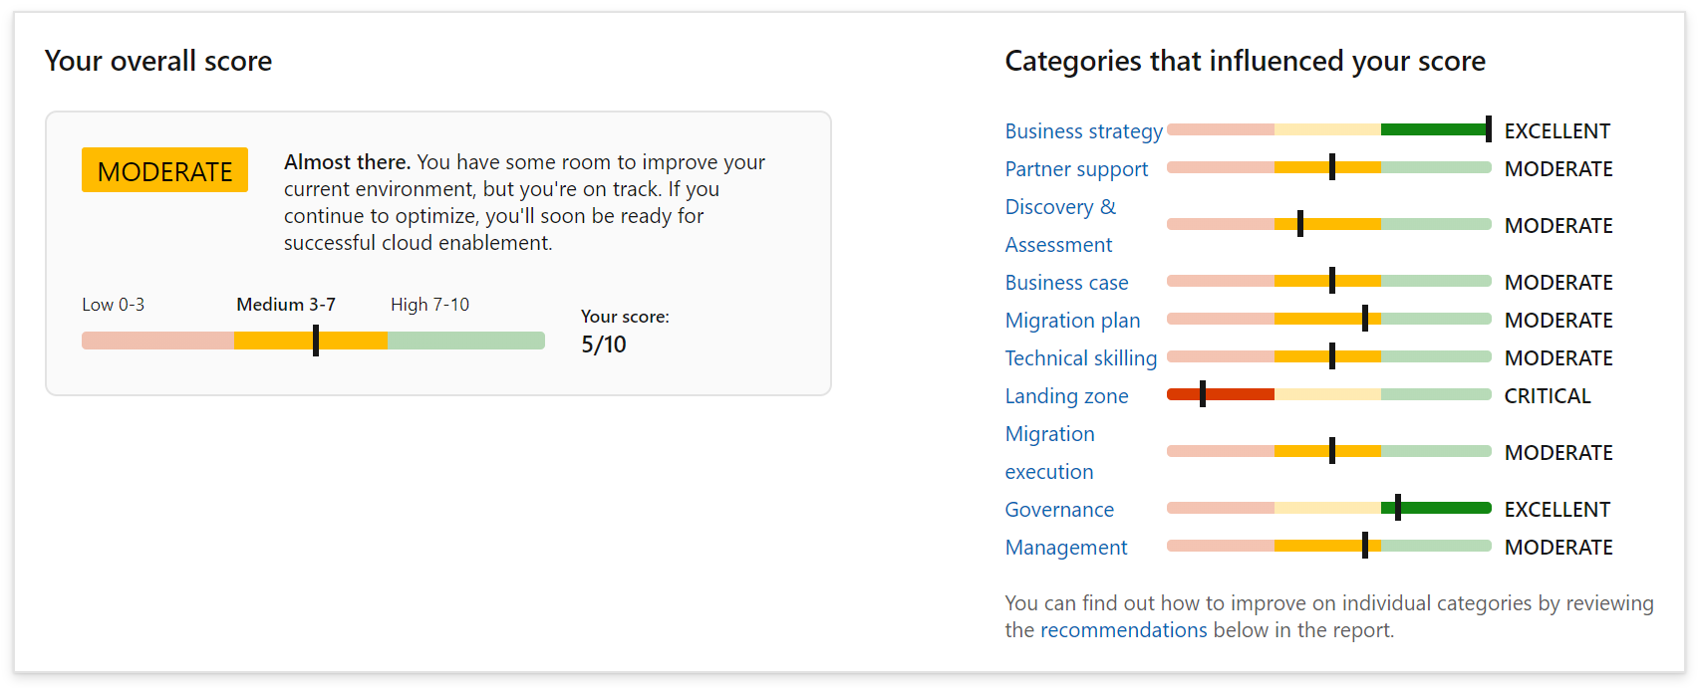
Assess your migration readiness
Use the Strategy Migration Assessment and Readiness tool across 10 readiness areas: aka.ms/smarttool
Notes:
<Key point>: The Strategy Migration and Readiness tool assesses migration readiness across 10 key areas.
[Recall the 10 key areas for migration preparedness]
Business strategy
Partner support
Discovery & Assessment
Business case
Migration plan
Technical skilling
Landing zone
Migration execution
Governance
Management
<Transition>: Let’s look at the prerequisite steps for the Migration phase.

Slide 9
Migration: pre-requisite steps
Before proceeding with migration execution, it is required that all the upstream steps of Strategy, Plan and Ready are completed. Key deliverable assets include – the Cloud Adoption Plan template and a landing zone configuration.
Migration waves
Define strategy
Define business justification and expected outcomes
Plan
Align actionable cloud adoption plan to business outcomes
Ready
Prepare people, process and environment for change
Adopt
Migrate or Innovate
Implement desired changes across IT and business processes
Govern
Comply, control and secure
Manage
Operate and optimize
Assess migration readiness: https://aka.ms/smarttool
Notes:
<Key point>: Before any migration, complete the Cloud Adoption Plan template and landing zone configuration in the Strategy, Plan, and Ready phases.
Assess and understand your comprehensive migration readiness with the SMART tool.
<Transition>: Let’s look at the Cloud Adoption Plan in more detail.

Slide 10
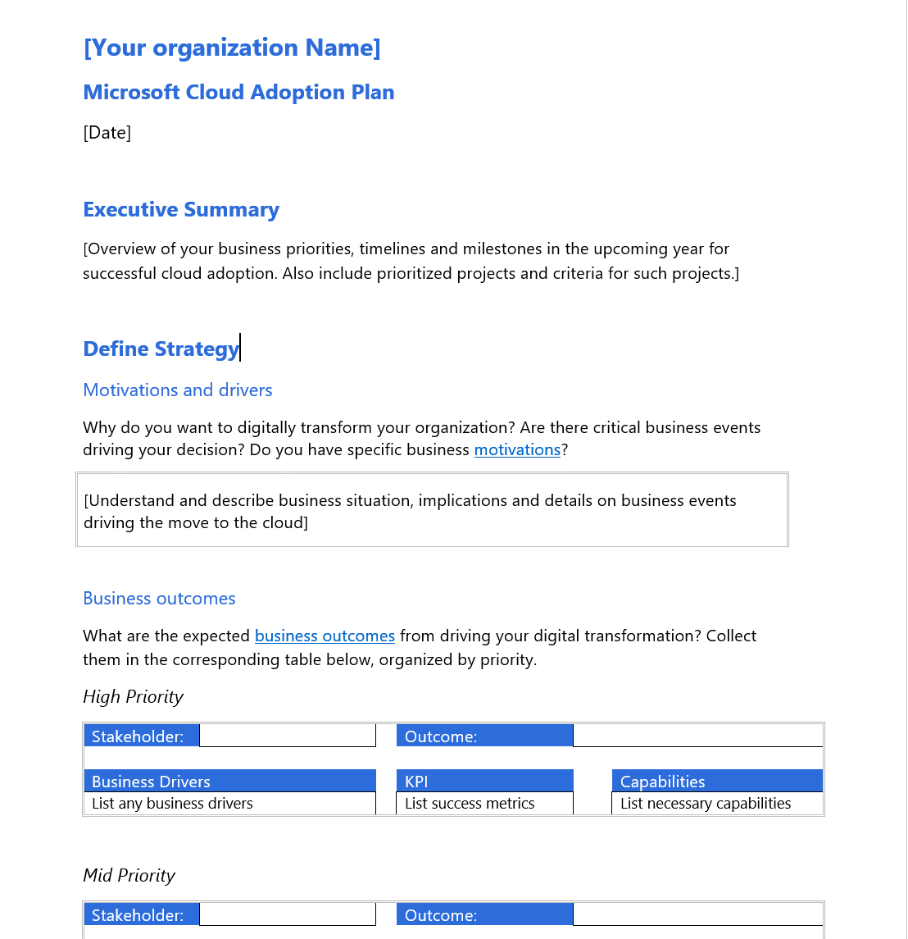

Review the Cloud Adoption Plan
The Cloud Adoption Plan template documents tasks around:
Executive sponsorship
Stakeholder alignment
Partner engagement
Digital estate analysis
Migration iteration waves including first adoption project
Governance requirements
Operations management requirements
Notes:
<Key point>: Completing the cloud adoption plan with an organization-wide, cross-team initiative aligns your teams, stakeholders, and partners on cloud adoption goals and strategies.
Document how your cloud adoption plan assesses each area around [go through topics of the Cloud Adoption Plan on slide].
<Transition>: Let’s look at your first landing zone configuration in more detail.

Slide 11
Azure landing zones - best practices
Notes:
[Title slide]

Slide 12
Landing zones What is their purpose?
Landing Zone (Subscription)
The purpose of a “landing zone” is to ensure that when a workload lands on Azure, the pre-provisioned landing zone environment is already in place to manage your cloud estate.
Landing zones ensure that your workload deployments have baked-in guardrails for agility and maintain compliance with enterprise security and governance requirements.
Roles e.g. NetOps, SecOps, DevOps
IAM
Management & Monitoring
Metrics, Logs, and Alerts
Security Center
Subscription Policy e.g. allowed resource providers
Encryption at-rest
No Public IP
Policy
Application
Application
Application
Application
App Resources (VM, DB, Storage)
Cost Management
IAM
Policy
Application Template
Keys
Monitor
Azure Monitor
Shared Services e.g. Active Directory (IaaS)
Inbound and Outbound
Corp Connectivity
Intra and Inter Landing Zone
Shared Services
Networking
Network Watcher
Security Center

Slide 13

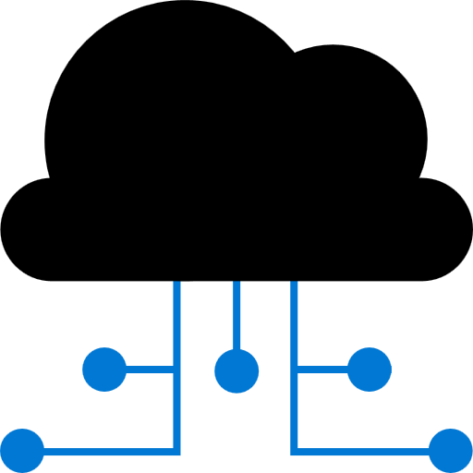
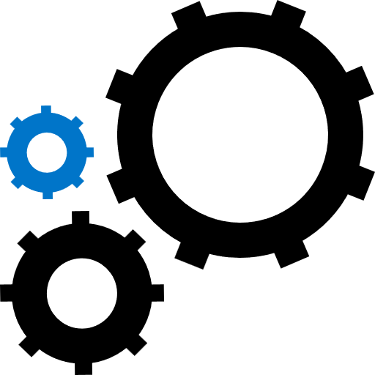
Azure landing zones What are they for?
Deploy
Manage
Prepare
Deploy foundation infrastructure resources for migrating your first workload to Azure.
Manage your cloud estate in alignment with the Microsoft Cloud Adoption Framework for Azure.
Prepare the new cloud environment with scale, security, governance, networking, and identity controls.

Slide 14

Azure landing zones Design areas
AAD Tenant and Billing
Governance Disciplines
Identity
Deployment Options
Resource Organization
Operations Baseline
Network Topology & Connectivity
Business Continuity & Disaster Recovery

Slide 15
How do you get started?
Azure Landing Zones
Foundation blueprint
Platform Development Velocity: how fast your cloud platform team can develop the required skills.
Iterative implementation
Migration blueprint
Terraform modules
What is an Azure landing zone? - Cloud Adoption Framework | Microsoft Docs
Rich initial implementation
Azure Landing Zone Acellerator
Notes:
<Key point>: Platform Development Velocity can be implemented in two ways.
With iterative implementations, customers are more tentative, and more deliberate in learning process. They want to start small, grow, and learn as they grow.
With a rich initial implementation, customers are more mature. They are looking for a robust implementation from day one.
[Go through options for each implementation]
[Call out short links on CAF landing zone documentation and ARM templates for customers’ next steps (GitHub documentation).
<Transition>: Let’s look at the Cloud Operating Model in more detail.

Slide 16




How do you get started?
W
W
W
W
W
W
W
W
W
W
W
W
Cloud Operating Model
W
Global Operations
W
W
W
W
Portfolio Operations
W
W
Central Operations
W
W
Workload
Landing Zones
Platform Foundation
Workload Operations
Notes:
<Key point>: Platform Development Velocity can be implemented in two ways.
With iterative implementations, customers are more tentative, and more deliberate in learning process. They want to start small, grow, and learn as they grow.
With a rich initial implementation, customers are more mature. They are looking for a robust implementation from day one.
[Go through options for each implementation]
[Call out short links on CAF landing zone documentation and ARM templates for customers’ next steps (GitHub documentation).
<Transition>: Let’s look at the Cloud Operating Model in more detail.

Slide 17

Cloud Adoption Framework foundation blueprint Customer Story 1
Situation
Complex technical decisions
100% parity between on-prem & cloud
Week 1
Week 4
Week 8
Week 12
Week 16
Week 20
Initial landing zone deployed
Manage disciplines implemented
Full-scale cloud deployment plan resumed
Deployed 3 low-risk production workloads
Govern disciplines implemented
CCoE team established
Key takeaways:
Creating landing zones unlocks cloud adoption through migration scenarios
Understand the customer’s approach – platform development velocity
As the team gained skills & confidence, they expanded scope and took on more complex workloads
Notes:
<Key point>: The first customer story comes from the CAF Foundation blueprint.
The customer found themselves in difficulty. They were concerned with their on-prem operating model and wanted to move it entirely to the cloud. It didn’t work, and the customer had some additional complexities in their on-prem environment that were not easy to migrate. The customer was blocked.
The Microsoft field team approached them, and said, “Let’s go slow.”
[Microsoft speaking to customer]: “Let’s help you understand that we can’t move everything at once. This is not parity 100% from on-prem to cloud, and let’s take that journey together.”
The customer agreed, and supported the Microsoft team, who began working with the CAF Foundation blueprint.
The landing zone was deployed in one week! Three weeks later, we already had a few low-risk workloads deployed in production in the landing zone.
In a month, the value of the cloud was proven to the customer. From that point, the customer was unblocked, and felt the growing confidence within their team.
The customer experienced comprehensive support from the Microsoft team—having the environment configured properly, growing with the customer as their skills grew, helping the customer move forward with governance and principles of cloud management—all the way to creating a Central Cloud Center of Excellence (CCoE), helping them move forward and grow in their journey.
[Review Key learnings]
key messaging:
“It was important for Microsoft to understand the kind of support the customer needs—enabling the customer to feel confident, grow, and develop as their implementation and portfolio on Azure grew.”
<Transition>: Let’s look at the second customer story.

Slide 18
Enterprise-Scale landing zones Customer Story 2
Situation
Existing ”landing zone”
Not ready for migration projects
Week 1
Week 4
Week 8
Week 12
Week 16
Week 20
Enterprise-scale landing zones deployed
Full-scale migration plan resumed
Vision agreed on and implementation to start
Critical migration milestones completed
Additional migration and new projects
Key takeaways:
Creating landing zones at scale unlocks cloud adoption through migration scenarios
Understand the customer’s approach – platform development velocity
Workshop sessions with customer to address landing zones design decisions – design areas
Notes:
<Key point>: The second customer story comes from the Enterprise-Scale Landing Zone.
This is a customer that is more mature. They already had several solutions, implementations, and landing zones running on Azure.
At this point, they had more important, complex, and critical projects than their previously environments on Azure. They now wanted to migrate these projects to Azure.
Therefore, the landing zones that they had already did not support these projects. The customer was blocked.
The Microsoft team, went in again, and shared the vision—the functionalities of the Enterprise Scale Landing Zones, communicating with the customer about:
The flexibility ESLZs have in their design configurations, the freedom to properly customize this robust environment to customers needs,
The thorough analysis required to define the architecture for a very robust landing zone.
Microsoft worked with the team, and worked with the customer, moving forward with a scenario where the customer was able to deploy the Enterprise-Scale Landing Zone.
The critical projects that needed to be migrated were completed in just a couple months after that.
[Review Key learnings]
key messaging:
“Not only was the customer blocked for these important projects, but they gained additional levels of confidence to move into new projects.”
“Microsoft is working with this customer in particular—working with them now on SAP and WBD projects that were not close to being considered.”
“This scenario is critical. Of course we are helping customers move forward with landing zones and deploying at scale. What was a good learning process for the team was the collaboration with the customer! It was not a simple one, two, three recipe. It was important to talk, and work with the customer in these working sessions—working with them, workshop-style, defining those landing zones, together.”
There are a lot of great opportunities with technology and technical guidance from Microsoft Azure—helping customers to move forward in their cloud journey.
<Transition>: Let’s look at how partners deliver landing zone guidance to customers.

Slide 19
Process and tools
Notes:
[Title slide]

Slide 20



Adopt migration execution
Migrate
Migration waves (releases)
Plan, Ready, and Adopt establish repeatable processes for iterative change management and digital transformation. Those processes establish waves of workload migrations (releases in agile terms).
Plan
Ready
Adopt
Migration effort (iterations)
Assess workloads
Assess each batch of workloads to evaluate cost, architecture, and deployment tooling.
Deploy workloads
Replicate functionality in the cloud using IaaS, PaaS, cloud-native, or other modernization solutions.
Release workloads
Test, optimize, document, and review. Release by handing off for governance, management, and security.
Assess each workload and finalize architectural decisions about migration options.
Initiate the migration of the environment using native tools, third-party tools, and project management tools.
Workloads should be tested, optimized, documented, and released for ongoing operations.
Review the migrated workloads and hand them off to governance, operations management, and security teams for ongoing support of those workloads.
https://aka.ms/adopt/migrate
Notes:
<Key point>: The migration process begins with an iterative Assess-Deploy-Release cycle that’s repeatable and predictable.
[Go over each point for Assess-Deploy-Release.]
[Review bullet points.]
<Transition>: Let’s look at templates, tools, and assessments in the Microsoft Azure Cloud Adoption Framework.

Slide 21



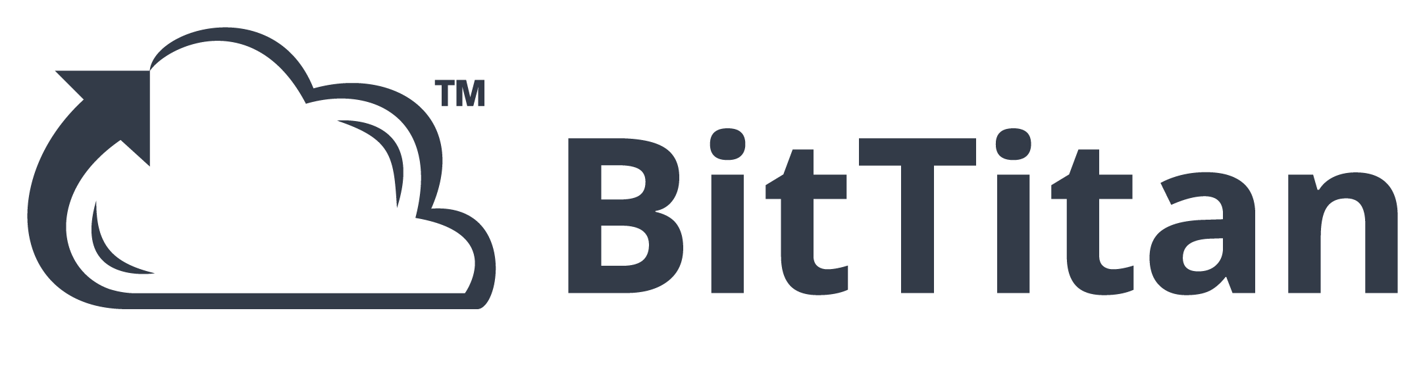
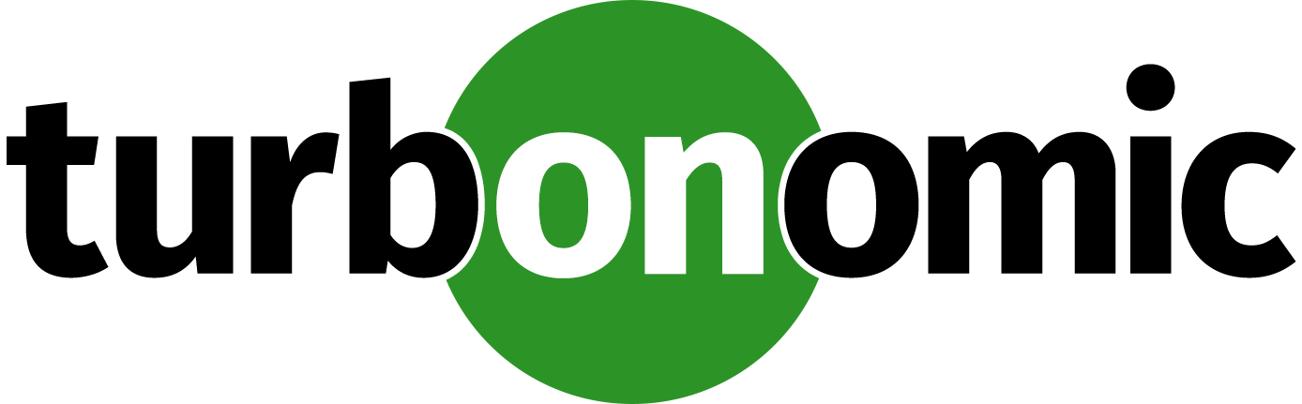






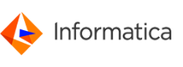


Migration tooling options
Assess workloads
Deploy workloads
Release workloads
Azure Migrate
Data Migration Assistant (DMA)
Azure Database Migration Service
Azure Cost Management
SQL Server Migration Assistant (SSMA)
Azure Data Box
Azure Advisor
Azure Monitor
Azure Security Center
ISV solutions (as needed)
Notes:
<Key point>: Make use of Microsoft and third-party tools in each phase of migration releases to ensure a successful Azure migration.
Call out the free Microsoft tools in the Azure portal.
And the third-party (ISV) tools to help support your migration requirements.
[Briefly skim over third-party offerings for migration tools].
We’re working closely with solution partners to build a consistent experience across Azure and third-party tools.
<Transition>: Let’s look at what Azure Migrate offers for migration initiatives.

Slide 22
Migration patterns | The five Rs of rationalization
What | Rehost | Refactor | Rearchitect | Rebuild | Replace
 | ls known as a lift and shift migration, a rehost effort moves a current state asset to the chosen cloud provider, with minimal change to overall architecture. | Refactoring code to enable an application to deliver on new business opportunities and fit a PaaS-based model. | Aging applications that aren't compatible with cloud providers might need to be rearchitected before transformation. Some applications might be more cost effective as cloud native solutions. | In some scenarios, the delta that must be overcome to carry an application forward can be too large to justify further investment. In this case, a new code base is created to align with a cloud-native approach. | Sometimes software as a service (SaaS) applications can provide all the necessary functionality for the hosted application.
Common drivers might include: | Reducing capital expense Freeing up datacenter space Achieving rapid return on investment in the cloud | Faster and shorter updates Code portability Greater cloud efficiency (resources, speed, cost, managed operations) | Application scale and agility Easier adoption of new cloud capabilities Mix of technology stacks | Accelerate innovation Build apps faster Reduce operational cost | Standardizing around industry-best practices Accelerating adoption of business process-driven approaches Reallocating development investments into applications that create competitive differentiation or advantages
Learn more: digital-estate/5-rs-of-rationalization
Notes:
<Key point>: Cloud rationalization evaluates assets to find the best way to migrate / modernize assets in the cloud.
The five Rs of rationalization are effective in identifying a potential future state for any workload that’s considered as a cloud candidate.
<Transition>: Let’s look at how migration tooling expands options for workload architectures.

Slide 23

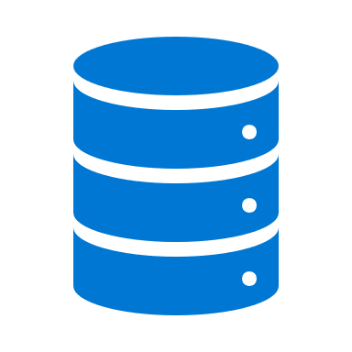




Migration tooling options
Assessment of an LOB Workload (N-tier App & Data)
Bandwidth Analysis
Storage: Data Box – Offline Transfer
Storage exceeds available bandwidth
Azure Storage
Re-hydrate from Azure Storage
Modernize App & Data
Yes
LOB App
Yes
App & Data: Refactor Pipeline/Re-Deploy
Refactor & Modernize
Expand workload architecture options with broad tooling options.
Dedicate VMs
Yes
Existing DevOps Pipeline
Azure App Service
App: App Service Migration Tool & Data: Azure Migrate – Database Migration
Migrate app and data to IaaS with no changes to the current state
No
Azure SQL (MI)
Hundreds of Apps per VM
LOB App
Innovation Potential
Migration is more than a lift and shift rehost to IaaS using tools like Azure Site Recovery.
Modernize some assets during migration with PaaS focused solutions like Database Migration Service.
Over time, refactor and modernize any workloads that represent innovation potential.
Yes
App & Data: Refactor Pipeline/Re-Deploy
Modernize Data Only
Yes
Existing DevOps Pipeline
Azure IaaS
App: Azure Migrate – Server Migration & Data: Azure Migrate – Database Migration
No
Azure SQL (MI)
Migrate app and data to IaaS with no changes to the current state
LOB App
Data Platform Analysis
Simple Data Platform
App: Azure Migrate – Server Migration & Data: Azure Migrate – Server Migration
Azure IaaS
Azure IaaS
Complex Data Platform: Cluster, High-Availability, Always On, etc.
LOB App
App: Azure Migrate – Server Migration & Data: Build New or Extend Hybrid Cluster – Synchronize data until promotion
Azure IaaS
Azure IaaS
Notes:
<Key point>: Multiple migration tooling options are available, depending on the architecture of on-premises workloads.
Communicate Azure migration solutions beyond simple rehosting (lift and shift).
Highlight tools and other deployment options.
<Transition>: Let’s look at Azure Migrate’s other useful functionalities.

Slide 24

Azure Migrate: a central hub for datacenter migration
Multiple scenarios
Migrate Windows and Linux Servers, Databases, Data, Web Applications and Virtual Desktops
Diverse capabilities
Comprehensive discovery, assessment, and migration capabilities powered by Azure and third-party tools
Centralized visibility
Centralized migration repository delivering end-to-end tracking and insights
Notes:
Azure Migrate is Microsoft’s most comprehensive first party migration service. It provides a hub of tools to Discover, assess, and migrate on-premises applications, infrastructure, and data. Centrally plan and track the migration across multiple Microsoft and independent software vendor (ISV) tools. Azure Migrate acts as an intelligent hub, so it provides recommendations and insights to move you along your migration journey based on your project and datacenter environment. And the service is free to use with an Azure subscription, no licensing cost required,

Slide 25
Common migration scenarios
Notes:
[Title slide]

Slide 26


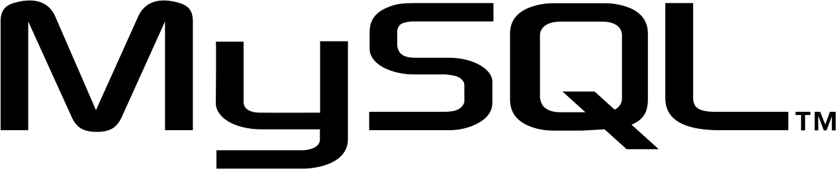
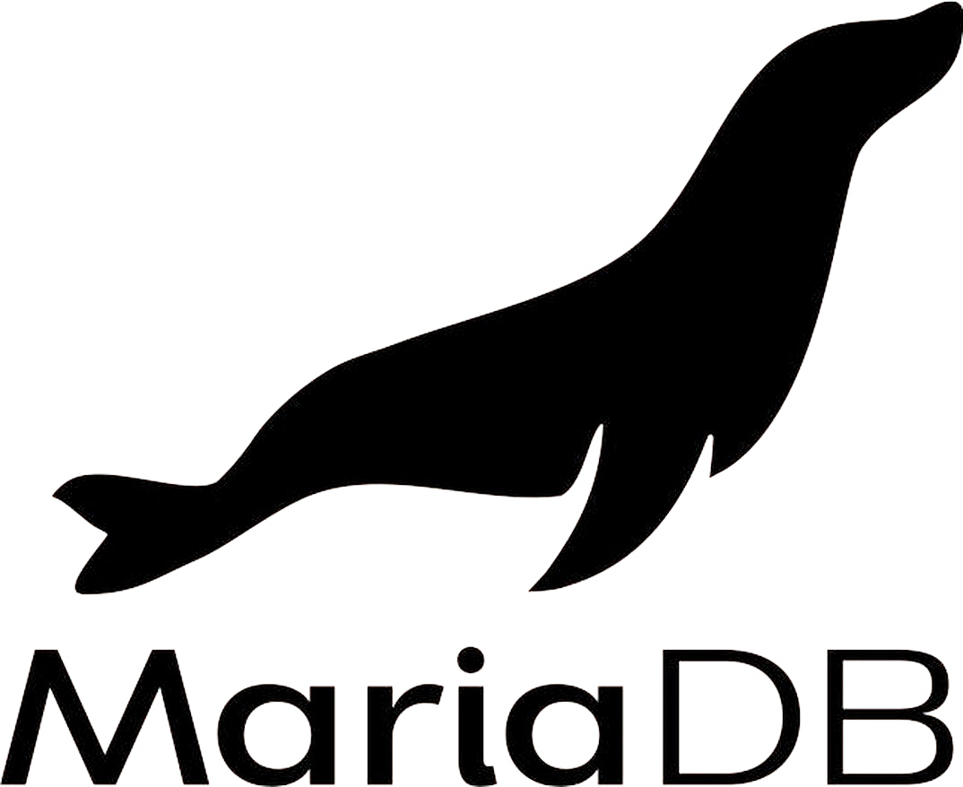

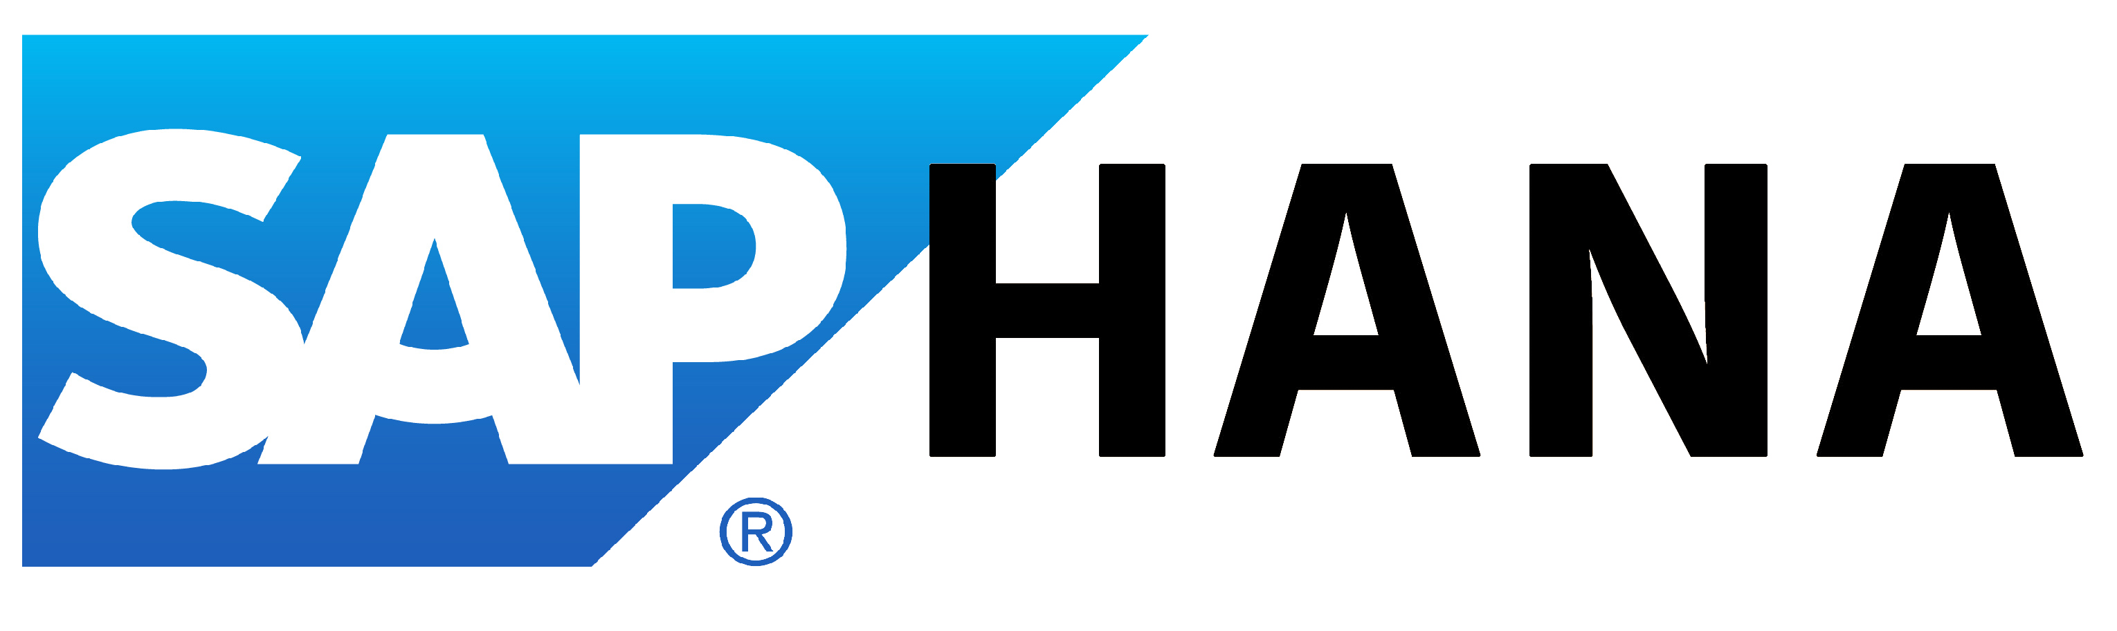

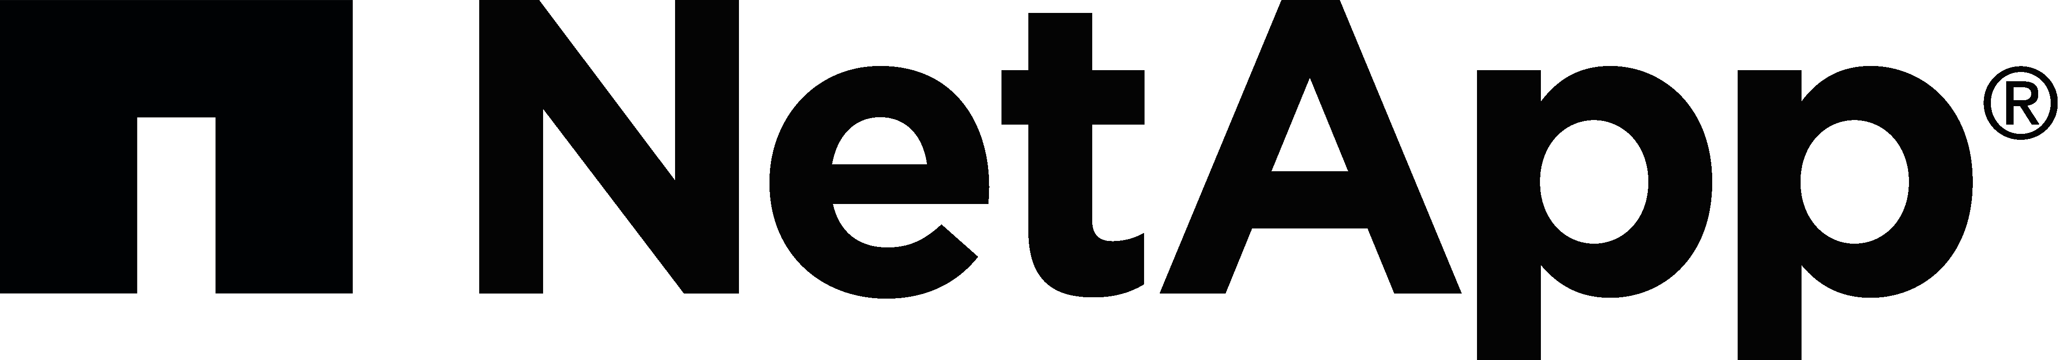



Common migration projects
Windows Server
SQL Server
Linux & Open source databases
Dev/test workloads
ASP.NET/PHP web apps
SAP
Specialized workloads
VDI workloads
Notes:
<Key point>: Here are some examples of common migration projects and associated workloads.
A customer’s environment might also have multiple workloads.
It’s important to understand all workloads in the migratable estate to address any requirements of specialized workloads, etc.
<Transition>: Lets' look at migrating VMware-virtualized apps to Azure VMware Solutions next.

Slide 27

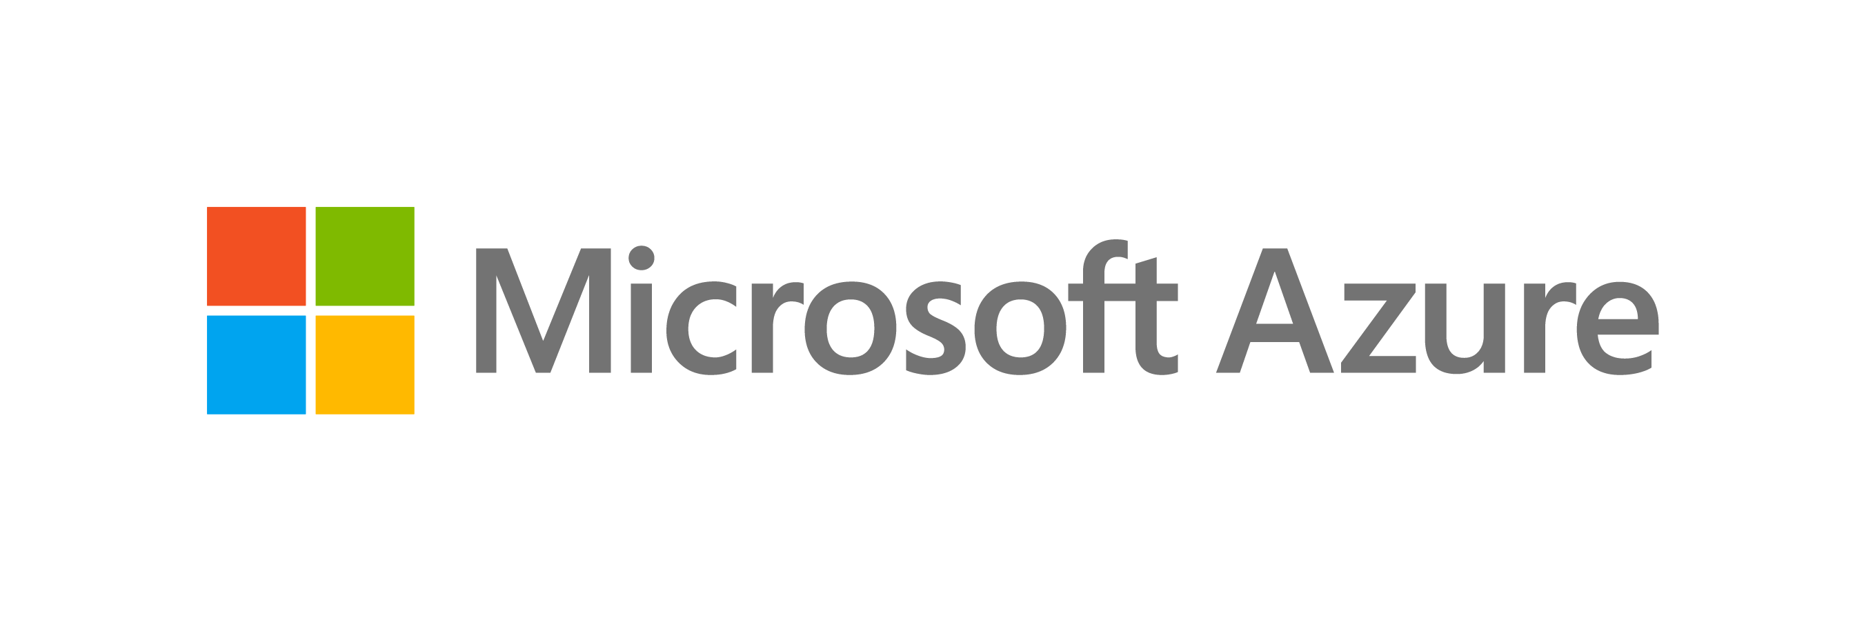
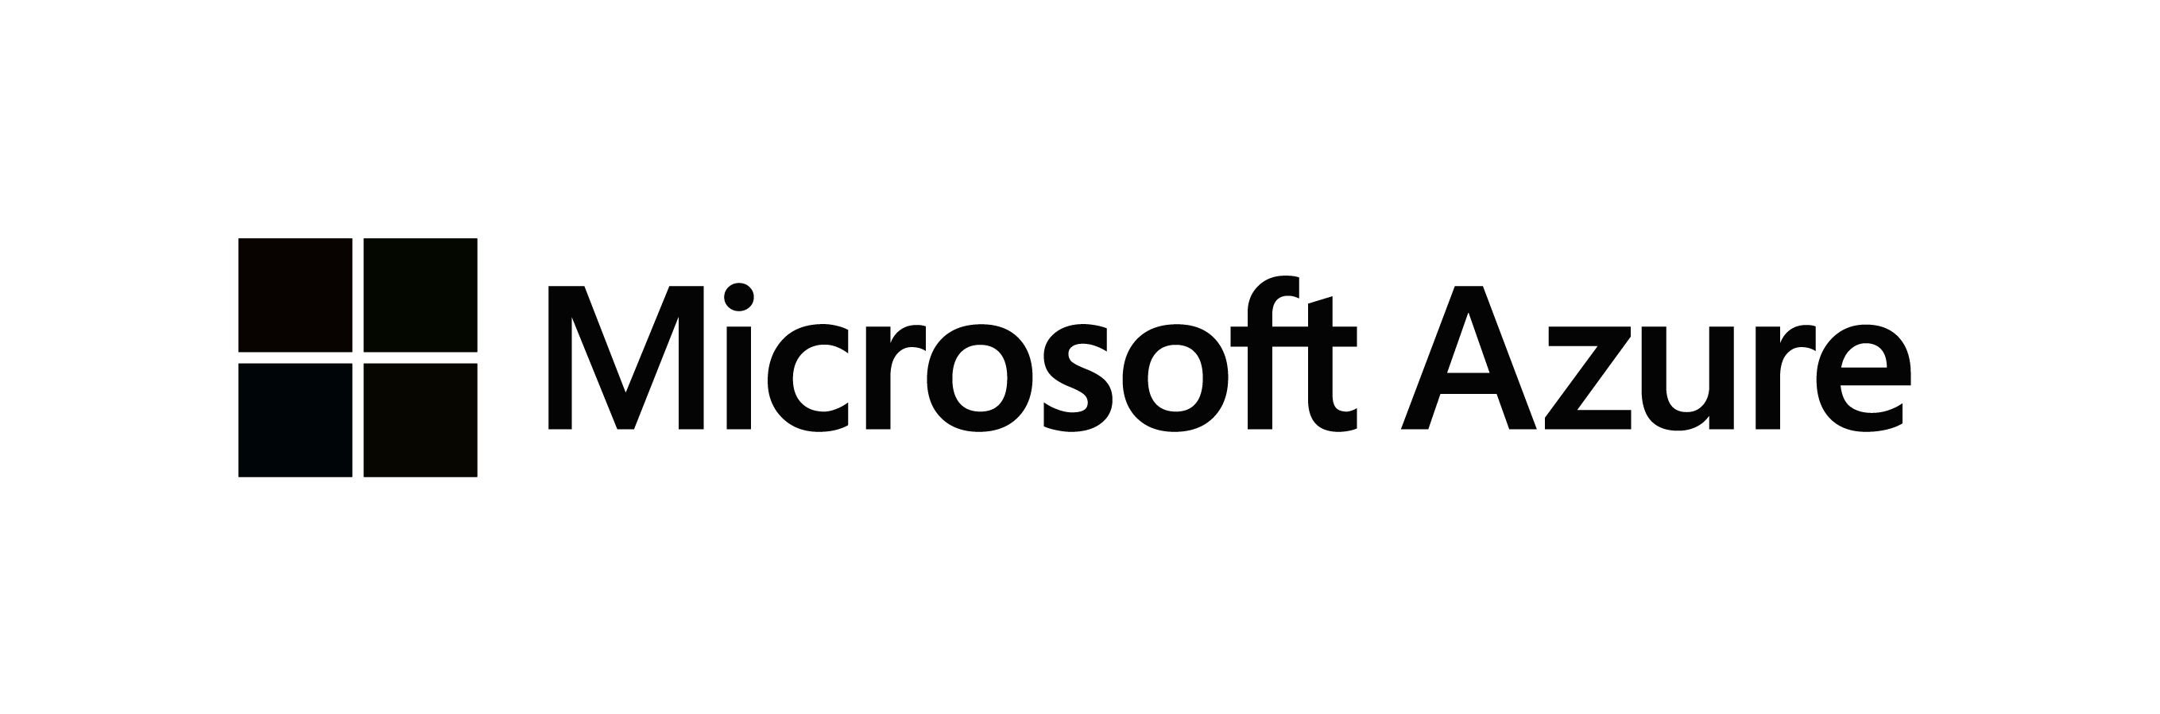
Migrating your workloads to Azure IaaS
LOB App
LOB App
Web/App layer
Azure IaaS
Azure Migrate
Server Migration
Data layer
Azure IaaS
VMware
AWS
Google Cloud

Slide 28
Migrating your VMware-virtualized infrastructure to Azure VMware Solution
LOB App
LOB App
Web/App layer
Web/App layer
VMware tools
Data layer
Data layer
VMware
Azure VMware Solution

Slide 29
Migrating your Virtual Desktop Infrastructure (VDI) to Windows Virtual Desktop
VDI Deployment
VDI Deployment
Azure Migrate (Integration with Lakeside for Assessment) Partner tools for Migration
Virtual Desktops (RDS/VMware/Citrix)
Windows Virtual Desktop (native or VMware/Citrix)
VDI Infrastructure
Azure IaaS
VMware
AWS
Google Cloud

Slide 30

Modernizing your .NET applications to Azure App Service & Azure SQL
LOB App
LOB App
Web/App layer (.NET)
Azure App Service
Azure Migrate Server Migration
Data layer
Azure SQL
Azure Migrate Database Migration
VMware
AWS
Google Cloud

Slide 31
Best practices
Notes:
[Title slide]

Slide 32
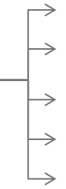

Best practice: setting up networking for migrated workloads
Implement a hub-and-spoke network topology
Design networks and subnets
Set up DNS
Prioritize the use of availability zones
Implement a highly available site to site VPN
Implement ExpressRoute for mission-critical connections
Optimize ExpressRoute routing with BGP communities
On-Premises
Spoke1
Spoke1
Spoke2
Spoke2
…
Internet
Internet
…
Spoke40
Hub
Hub
Spoke40
Spare Spoke
Spare Spoke
Spare Spoke
Internet
Spare Spoke
…
…
Hub
Spoke1
…
Spoke40
Spare Spoke
Spare Spoke
…
Notes:
<Key point>: Implement best practices when setting up networking for migrated workloads.
[Review best practices recommendations.]
<Transition>: Let’s look at best practices for extending networking to Azure.

Slide 33
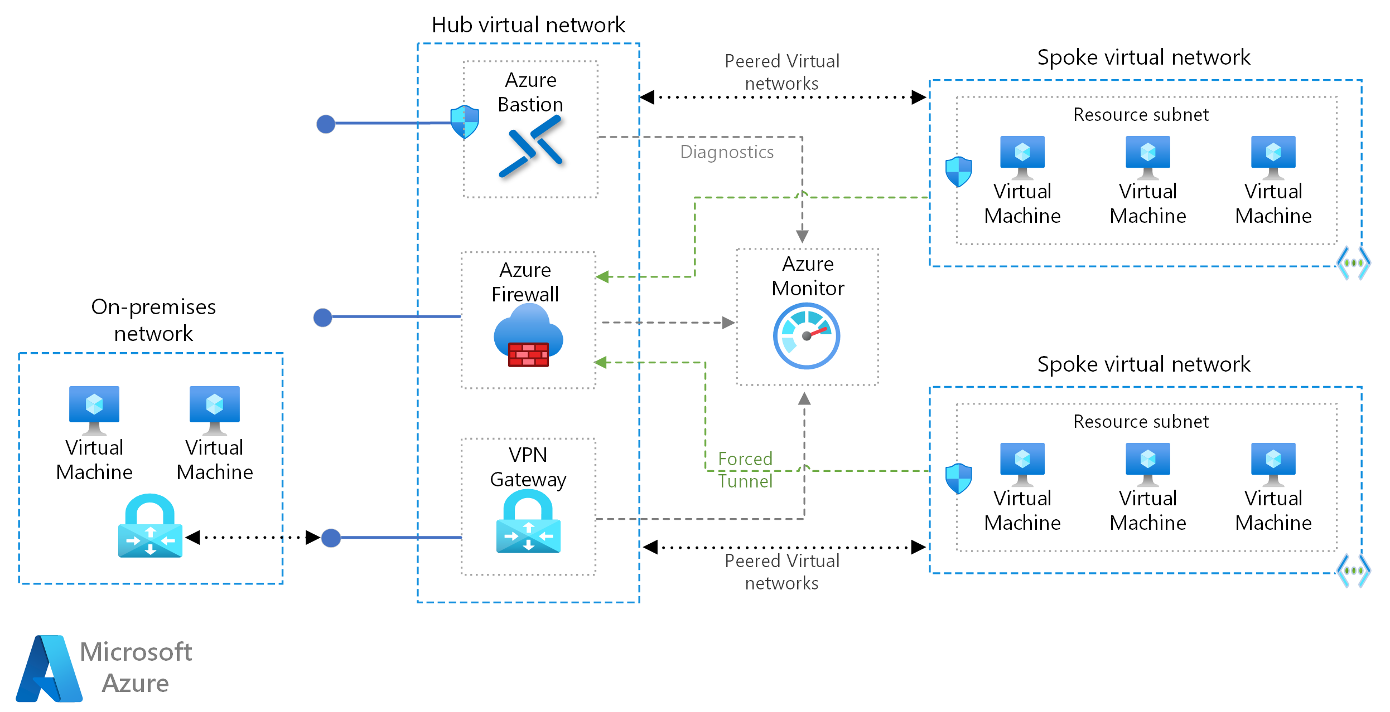
Best practice: extending networking to Azure
Notes:
<Key point>: It’s essential to invest in identity and networking as you scale up migration efforts.
You need a common identity infrastructure which can help you quickly establish single sign on access to your migrated resources.
And for apps/workloads that are distributed across Azure and on-prem, you need secure, dedicated connectivity to ensure QoS needs are met.
Solution
Scenario 1 (optimized for single sign on):
Use Azure AD to create an Active Directory domain in the cloud and connect it to your on-premises Active Directory domain. Azure AD Connect integrates your on-premises directories with Azure AD. Azure AD Connect will integrate your on-premises directories with Azure Active Directory.
This allows you to provide a common identity for your users for Office 365, Azure, and SaaS applications integrated with Azure AD.
Scenario 2 (optimized for high performance integration between Azure and on-prem workloads):
Extend your existing on-premises Active Directory infrastructure to Azure, by deploying a VM in Azure that runs AD DS as a domain controller.
This architecture is more common when the on-premises network and the Azure virtual network (VNet) are connected by a VPN or ExpressRoute connection.
<Transition>: Let’s look at best practices for extending identity to Azure.

Slide 34

Best practice: cost-optimize migrated workloads
Before Migration
After Migration
Estimate monthly workload costs
Right size VMs
Select the right storage
Take advantage of Azure Hybrid benefits
Use reserved VM instances
Aggregate cloud spend across subscriptions
Use Azure Cost Management
Monitor resource utilization
Implement resource group budgets
Optimize Azure Monitor retention
Optimize storage
Automate VM optimization
Implement serverless technologies
Use Logic Apps and runbooks with Budgets API
Notes:
<Key point>: It’s essential to use best practices when cost-optimizing your workloads on Azure, before and after migration.
[Review best practices recommendations under headings: Before Migration and After Migration.
<Transition>: Let’s look at best practices about scaling a migration on Azure.

Slide 35

Best practice: scale a migration
Estimate monthly workload costs
Right size VMs
Select the right storage
Take advantage of Azure hybrid benefits
Use Reserved VM instances
Aggregate cloud spend across subscriptions
Use Azure cost management
Leverage reference architectures to scale
Notes:
<Key point>: It’s important to use best practices when scaling up migration efforts.
[Review best practices recommendations.]
<Transition>: Let’s look at best practices for migrated workloads during the ‘Govern’ and ‘Manage’ phases of the Microsoft Cloud Adoption Framework for Azure.
.

Slide 36
Govern and manage migrated workloads
After a successful workload migration, the adoption team should hand off to governance and operations teams to ensure the workload is well-governed and optimized.
Migration waves
Define strategy
Plan
Ready
Adopt
Govern
Manage
Notes:
<Key point>: It’s important to use best practices for workloads during the ‘Govern’ and ‘Manage’ phases.
[Review best practices recommendations.]
<Transition>: Let’s look at the next steps you can take to accelerate your digital transformation.
.

Slide 37
Azure Migration and Modernization Program (AMMP)
Optimize costs and migrate with confidence with the right expert help at every stage. Use best-practice guidance, direct access to Azure engineers, tools, and specialized partners.
Proven methodology: Cloud Adoption Framework
Free tools: Azure Migrate
Cost-effective offers & incentives
In-depth assistance from FastTrack for Azure engineers
Technical skill building
Expert help from specialized partners
Learn more & nominate | Azure.com/AMMP
Notes:
The Azure Migration and Modernization Program gives you prescriptive guidance for a step by step approach to cloud migration. AMMP offers the opportunity to work closely with Microsoft experts and specialized migration partners to simplify and accelerate your migration.
The program delivers:
Best practices for a step by step approach from start to finish
Technical skill building to ensure your organization can successfully adopt Azure
FastTrack for Azure engineering assistance for data and infrastructure foundations
Expert guidance from specialized migration partners
Free Azure tools like Azure Migrate to help you efficiently execute migrations
And cost effective offers to help you save money before, during, and after migration

Slide 38
Next steps - resources

Slide 39
Resources
Find a partner
https://aka.ms/adopt/ findapartner
Take an assessment
https://aka.ms/adopt/ assess
Read documentation
https://aka.ms/adopt/ overview
Find consulting services
Microsoft Consulting Services
Complete learning module
Microsoft Learn
Sign up for Azure Migration and Modernization Program
https://azure.com/AMMP
Notes:
<Key point> There are a variety of next steps you can take to accelerate your digital transformation journey.
[Review main resources on slide.]
<Transition>: Thank you!

Slide 40
Thank you

